Slide 1
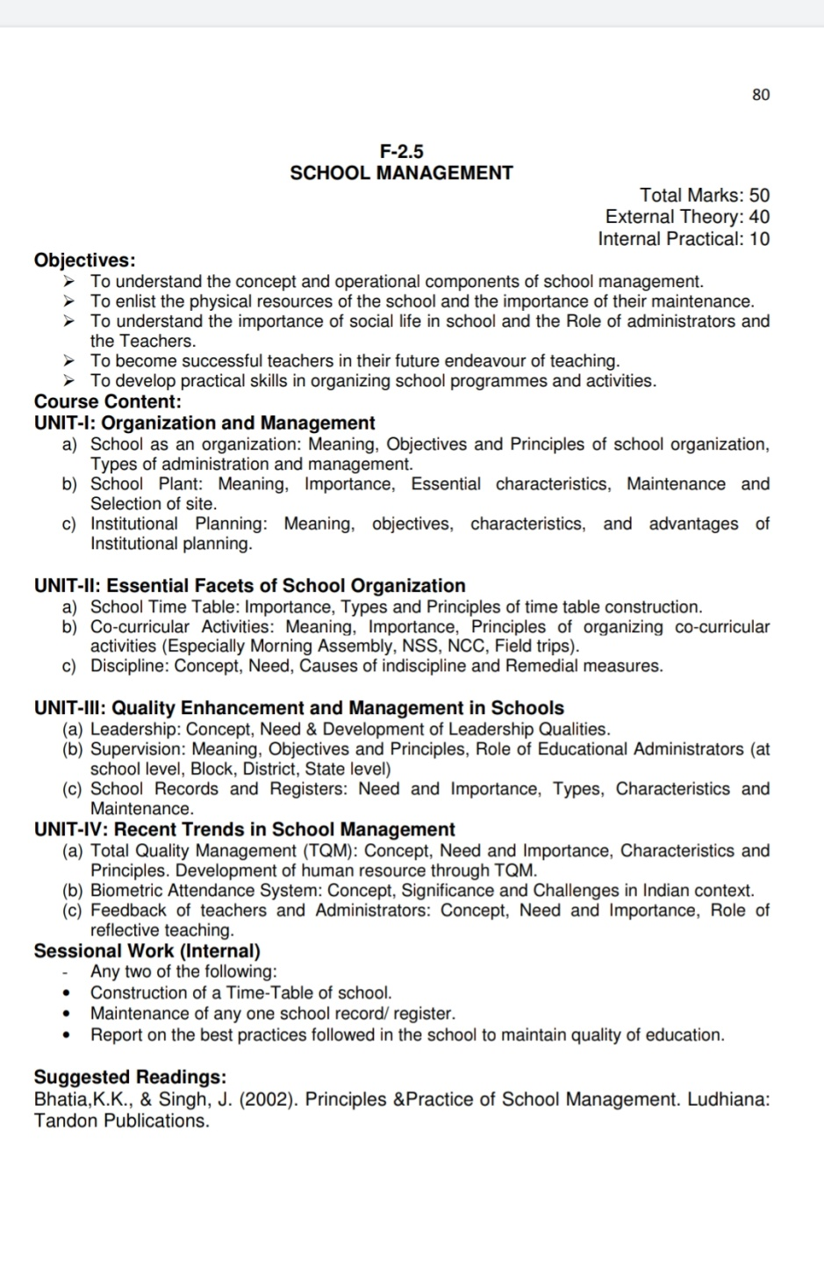

Slide 2
School Full Form
S= Sincerity(Truth)
C=Capacity(Shamta)
H=Honesty(Emaandaar)
O= Orderliness(Order)
O= Obedience(Aagyakari)
L=Learning(sikhna)

Slide 3
Meaning of School
Kothari commission rightly says” The destiny of India is now being shaped in her class rooms.”

Slide 4
Meaning Of Organisation
The word organisation has been derived from the word organ,
Organ means various part of body.
All the organs help in proper functioning of body.
Similarly a school need proper organisation to care out the work properly.
According to the stead views “Organisation is that agency by which we achieve the desired objectives”

Slide 5
Meaning Of School Organisation
School + Organisation
School organisation means to organise human capitals, materials, thoughts, elements ,rules and regulations in such manners by which we achieve desire objectives.

Slide 6
MANAGMENT
According to dictionary meaning “Management is the art of getting things through others”.

Slide 7
SCHOOL MANAGMENT
According to Henry Fayol” To manage is to forecast to plan, to organise, to command, to coordinate and to control.”

Slide 8
School Plant
According to advanced learners dictionary “Campus means grounds of a school, college or university where the main buildings are”
H(Human) + M(Material)
1.(H) Need of the physical resources:- student, school staff, standard of education good learning and good teaching.

Slide 9
2.(M) Material resources
1.School Building
2. Room(principal, teaching staff,class,computer,science multi purpose hall)
3.Furniture , 4. Library, 5.Labortaory, 6.Art Gallery ,.7.Museum,8.playgound, 9.canteen, 10.School record room
11 All types of activities
12. Bathroom, 13.cycle stand,14.drinking water,15. school dispensary

Slide 10
Location and Selection of site of school plant
Satisfaction of local needs
Surrounding( ala duaala)
Level of land of school
Proper site
Easy accessibility
Service conditions
Area of expand in future
Design of school plant
Use of school plant
Direction of school plant
Safety of school plant

Slide 11
Institutional Planning
Meaning of institute a business organisation , a school, college or a coaching centre.
They are establish for particular purpose.
Meaning of planning
What to do?
When to do?
How to do?
Who will do a particular task?

Slide 12
Institutional Planning
M.B. BUCH –”A programme of development and improvement prepared by an educational institution on the basis of its felt needs and the resources available or likely to be available with improvement the school programme and school practices,contitues a plan for an institution.it is based on the principle of optimum utilization of the resources available in the school and community. The plan may be for a longer duration or shorter duration.”

Slide 13
Types Of School Organisation, Administration And Management
Dictator Administration | Democratic Administration
Single leadership | Principal of sharing responsibility
Profit centred source of power | Principal of equality
Difficulty in developing skill | Principal of justice
All around development of student is not possible | Principal of leadership
Limited area | Principal of flexibility
Self directed | Principal of coordination
Based in heredity | Principal of optimism
Rigid discipline | Principal of value

Slide 14
Characteristics of school Organisation / Management/ administration / school plant and institute planning
Safety,
Well-being,
Coordination
Efficacy,
Unity,
Beauty,
Flexibility,
Economy
Based on need
Education centred
Goal centred
Democratic
Related with community
Mobility
Motivation

Slide 15
Need/ Objectives/Importance of school Organisation / Management/ administration / school plant and institute planning
For achieving educational objectives
For achieving efficiency and effectiveness
Defining functions of school
For achieving group goals
Coordination in all school activities
Minimum wastage
For physical development
For moral development
For social development
For mental development
For vocational training
For creating suitable environment
Democratic planning
For maintaining discipline
National development
For maintaining equality in education for progress of society

