Slide 1
  WELCOME

Slide 2
. Means and types
Meaning And Types Of Education

Slide 3
Introduction to Education
  It is not the Learning of facts,
But the training of mind to think
Albert Einstein

Slide 4
Education
Educare which means ‘to bring out’ or ‘to nourish’
The word “Educate” come from Latin word” Educere” which means to lead out or Bring out.
Educatum which means ‘act of teaching’ or ‘training.’
Education is the process of Bringing desirable change into the behaviour of the human being.

Slide 5
Indian views
Acc. to Rigveda, ‘Education is that which makes a man self reliant and selfless.’
Kautilya , ‘Education means training and love for nation’
Mahatma Gandhi has said “By education, I meant all round drawing out of the best in child and man body mind and spirit.’’

Slide 6
Western views
Socrates “ Education means the bringing out of ideas of universal validity which are latent in the mind of every man.”
Helbert Spencer “Education is complete living.”
Rousseau “Education is child’s development within.”

Slide 7
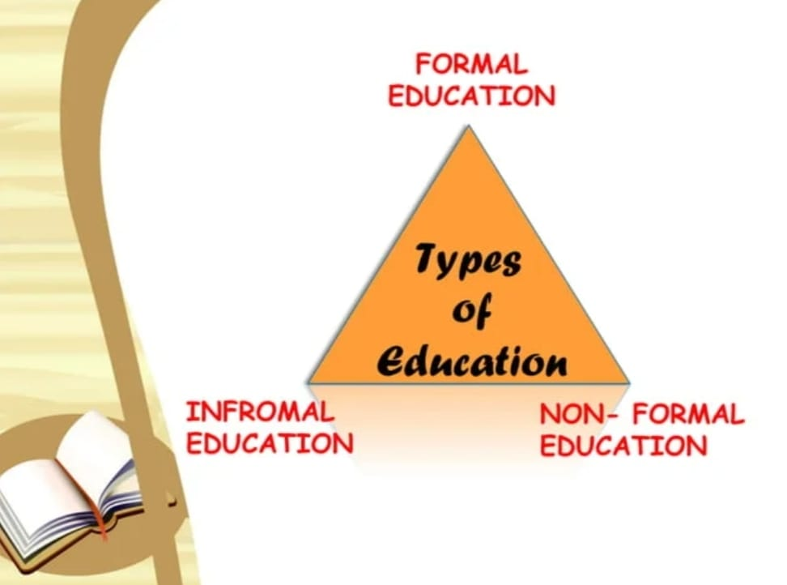
Types of Education

Slide 8
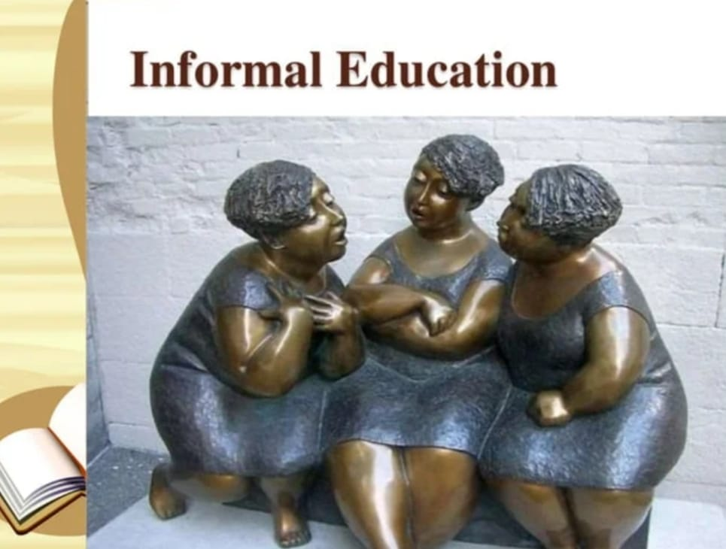

Slide 9
Informal Education
Informal Education is:
1. Life long process.
2.Individual learnt from daily experiences
3.Individual learns from exposure to the environment at home, at work, at play etc.

Slide 10


Slide 11

Formal Education

Slide 12
Formal Education
1. Institutional activity
2. Chronologically graded structure
3.Uniform
4. Subject oriented
5. Full time
6.Leads to certificates, diplomas, degrees.

Slide 13
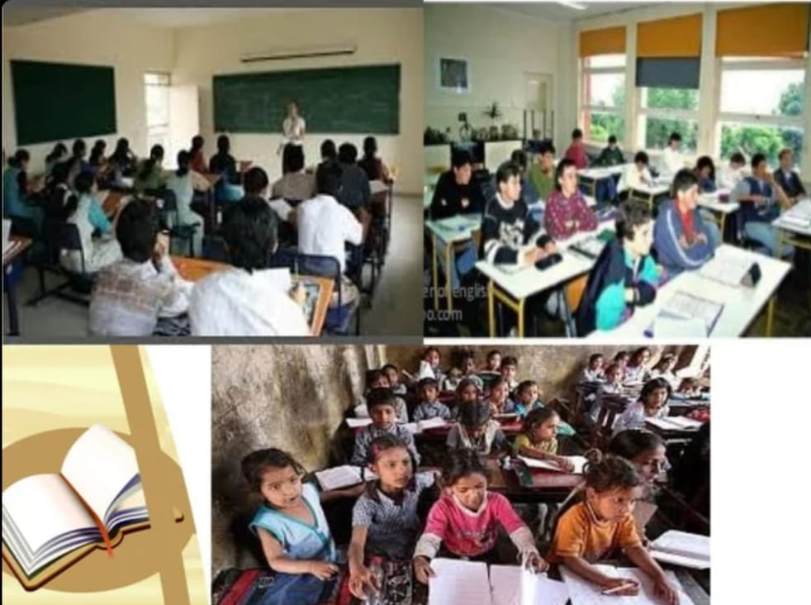

Slide 14
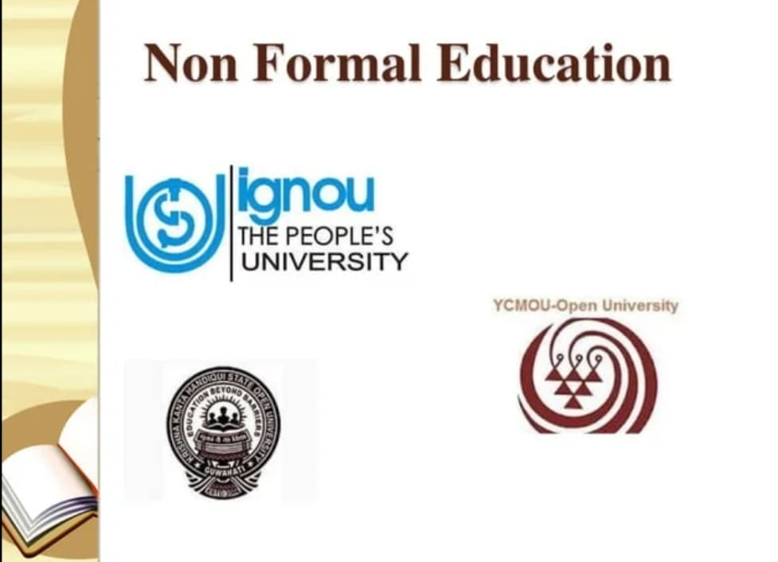

Slide 15
Non formal Education
1. Flexible
2.Life, environment and learner oriented.
3. Diversified in content and method.
4. Built on learner Participation.
5. It mobilizes local resources.
6. It enriches human and environmental potential.
E.g. Open University’s courses.

Slide 16

Distance Learning

Slide 17
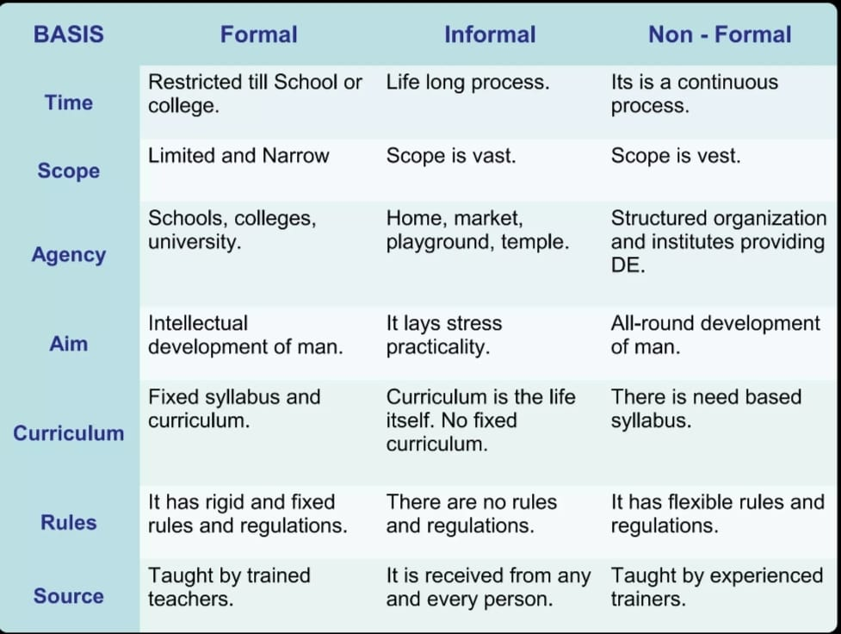

Slide 18
.
THANKS

