Slide 1
Knowledge
Knowledge- Concept, Nature and Sources of Knowledge.

Slide 2
Concept of Knowledge
Acc. to oxford dictionary “Expertise and skills required by a person through
Experience or Education
Theoretical or Practical
understanding of a subject is called knowledge.

Slide 3

Concept of Knowledge Plato - JBT

Slide 4
Concept of Knowledge
Acc. to Buddhist “knowledge is that which relives man from worldly sufferings”.
Acc. To Webstar “ information gained through actually experienced”.

Slide 5
Types of Knowledge
Plato
School Knowledge
Out of school knowledge
Shankar
Apra Knowledge
Pra Knowledge

Slide 6
Types of Knowledge
Personnel knowledge
General knowledge
Formal knowledge
Informal knowledge
Abstract knowledge
Concrete Knowledge
Structured knowledge

Slide 7
Types of Knowledge
Local knowledge
Universal knowledge
Theoretical knowledge
Practical knowledge
Contextual knowledge
Textual knowledge

Slide 8
Nature of knowledge
Knowledge is a group of beliefs.
Knowledge once approval.
Knowledge requires some grounds and regions.
Knowledge is valid.
Knowledge is power to control.
Knowledge is power to manipulate the environment

Slide 9
Nature of knowledge
7. Knowledge is transferable.
8. Knowledge is an assets (ek sampatti)
9. Knowledge is moving.
10. Knowledge is always increase.
11. It increase with sharing.
12. It is belief.
13. It is meant to reach truth.
14. Knowledge is both limited and limitless.
15. Knowledge is based on values and facts.

Slide 10
Sources of Knowledge
Types of Sources

Slide 11
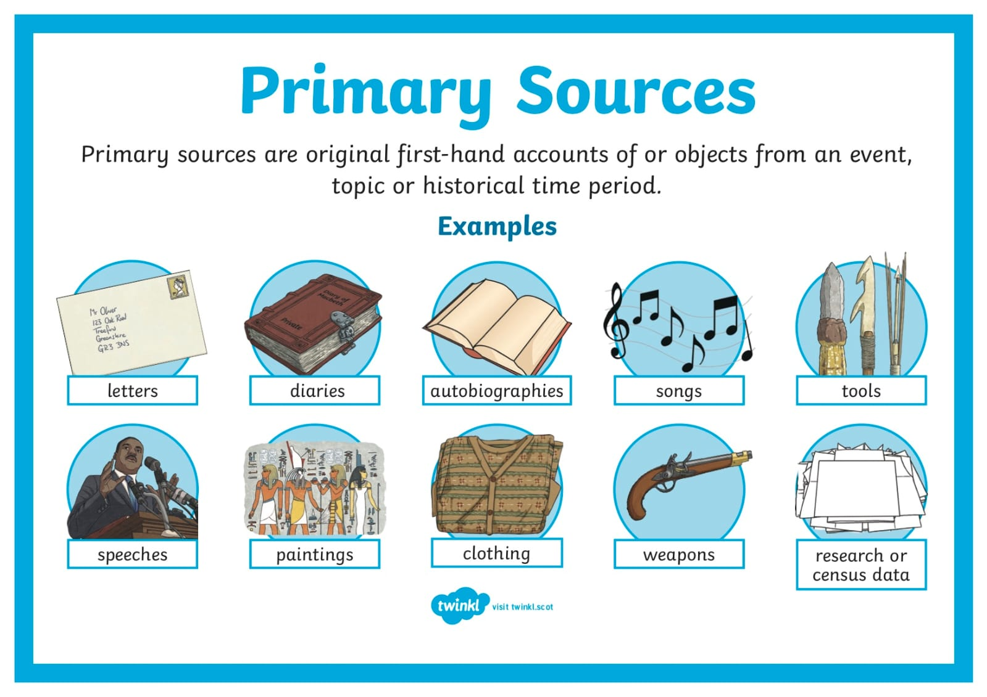
Sources of Knowledge

Slide 12
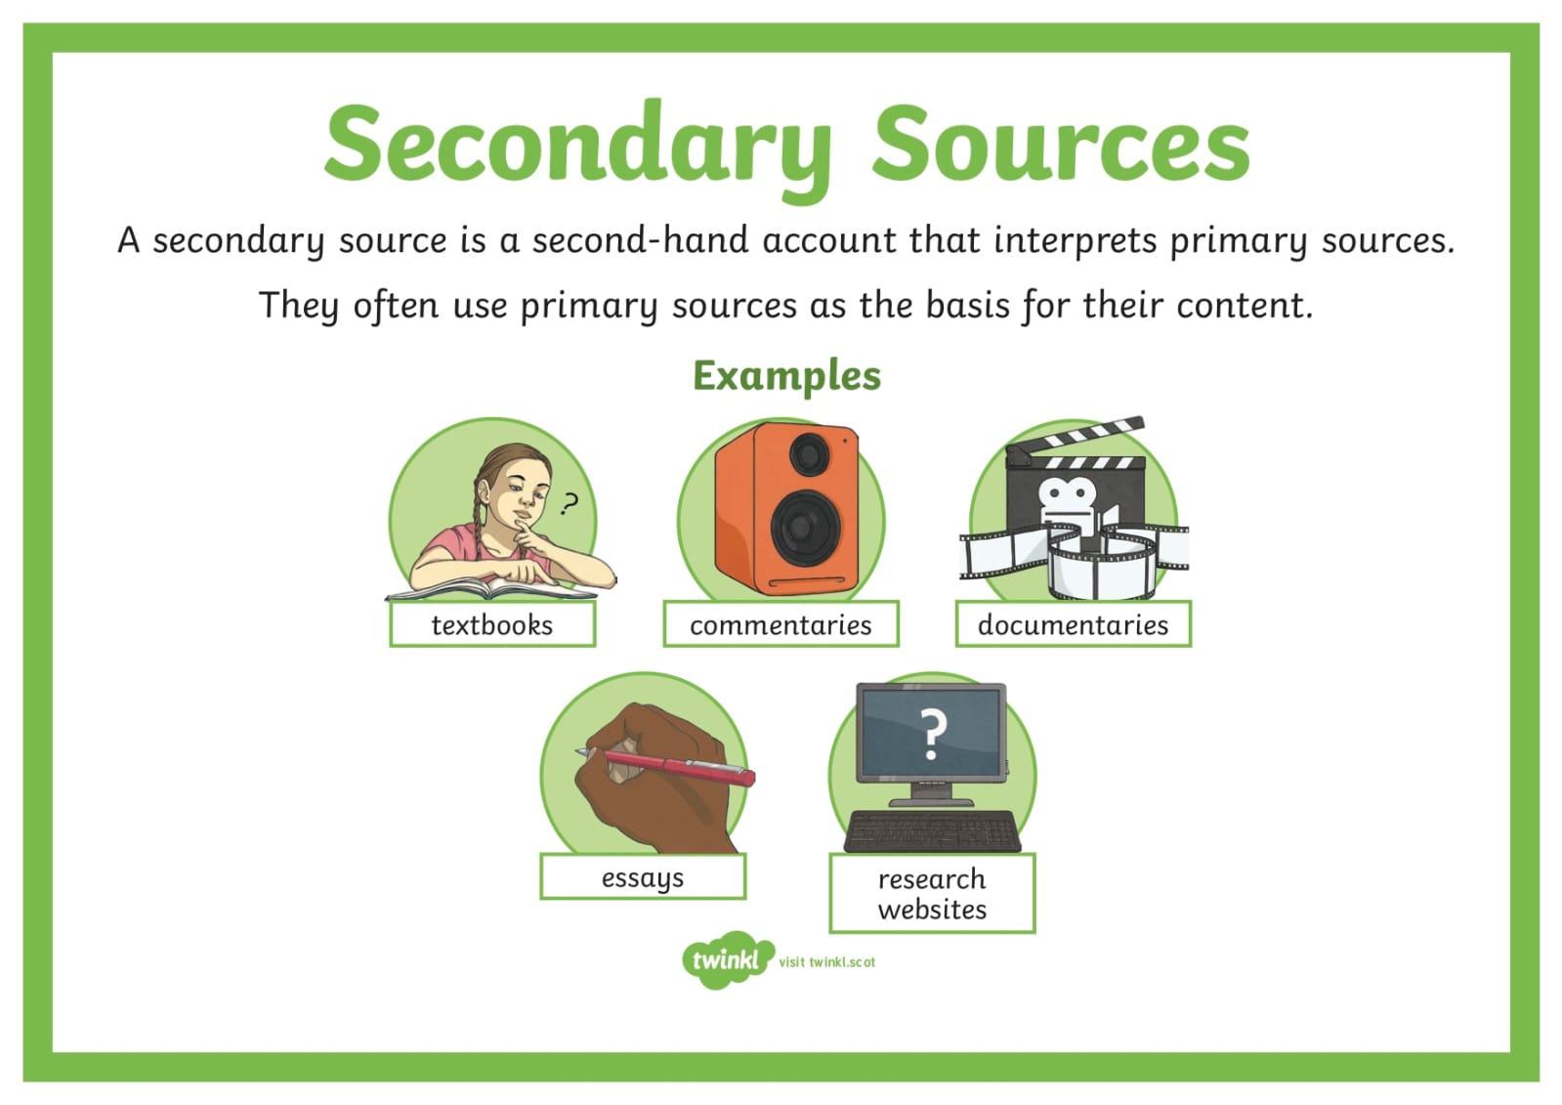
Sources of Knowledge

Slide 13
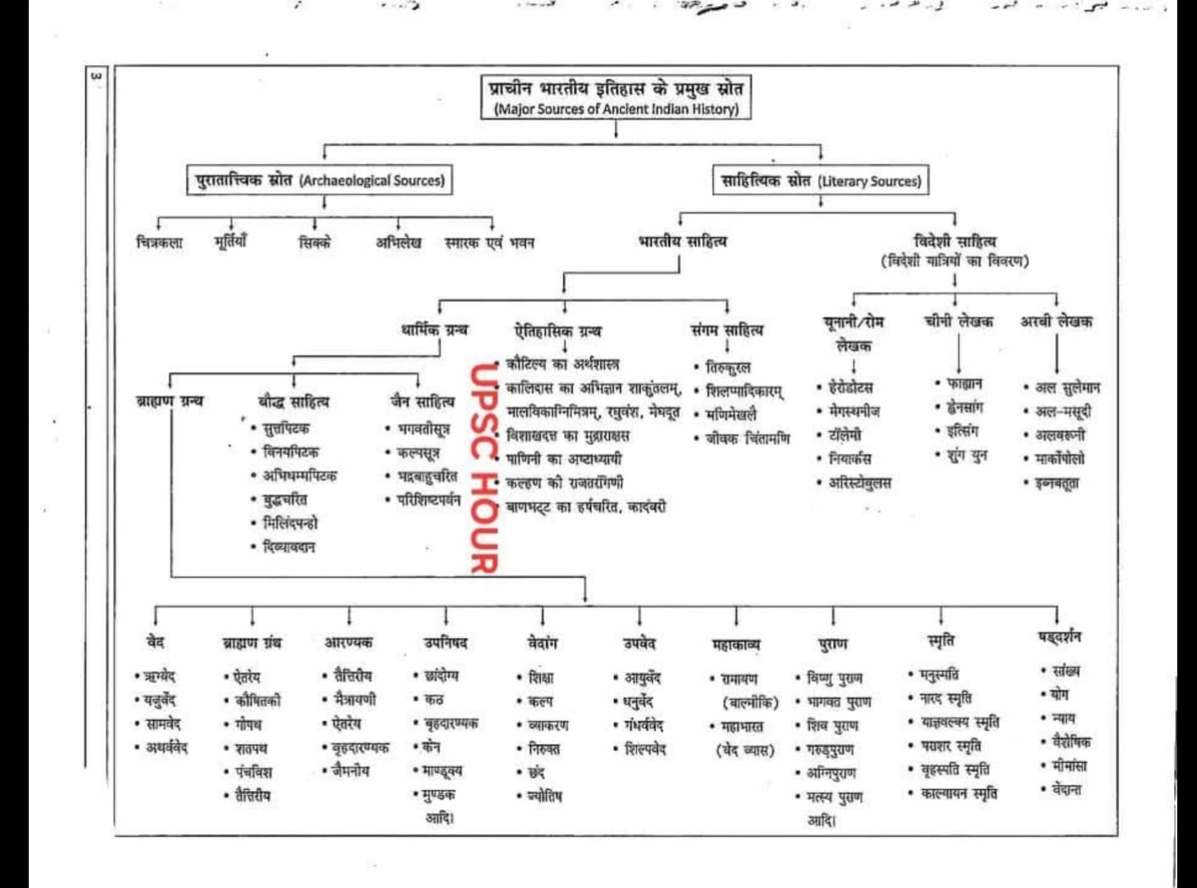

Slide 14
Sources of Knowledge
Culture
Experience
Experiment / Project Method
Insight
Inference(Anumaan)
News paper
Trip / Tour

Slide 15
Sources of Knowledge
Self Realisation
Memory
Observation
Reason
Authority(Adikari)
Superstitions( Vehm Bharam)

Slide 16
-
THANKS

