Slide 1
🏸 1. Badminton Court: Layout, Rules and Regulations
Layout of Badminton Court
Shape: Rectangular
Length: 13.40 m
Width:
  Singles: 5.18 m
  Doubles: 6.10 m
Net Height:
  Center: 1.524 m
  Posts: 1.55 m
Important Lines:
Center Line
Short Service Line
Long Service Line
Side Lines
Back Boundary Line

Slide 2
Rules and Regulations
A match is played between two players (singles) or two pairs (doubles).
Each game is of 21 points.
The player who scores 21 points first wins the game.
A match consists of best of three games.
Shuttle must pass over the net.
Only one hit is allowed on each side.
Server must serve diagonally.
Touching the net is a fault.

Slide 3
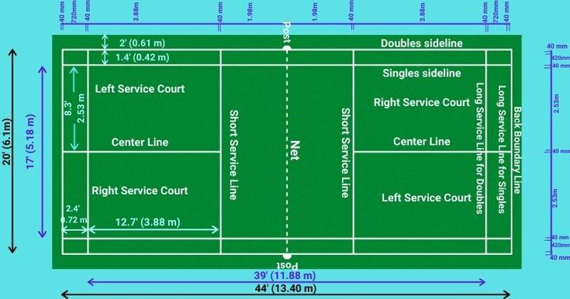

Slide 4
🏐 2. Volleyball Court:
Layout, Rules and Regulations
Layout of Volleyball Court
Shape: Rectangular
Length: 18 m
Width: 9 m
Net Height:
  Men: 2.43 m
  Women: 2.24 m

Slide 5
Important Lines:
Center Line
Attack Line (3 m Line)
End Line
Side Line
Service Area

Slide 6
Rules and Regulations
Each team has 6 players.
A match is played in 5 sets.
First four sets: 25 points
Fifth set: 15 points
A team must win by 2 points.
Maximum 3 touches per team before sending ball over.
Same player cannot touch the ball twice continuously.
Rotation is compulsory after winning service.
Ball must not touch the ground inside court.

Slide 7
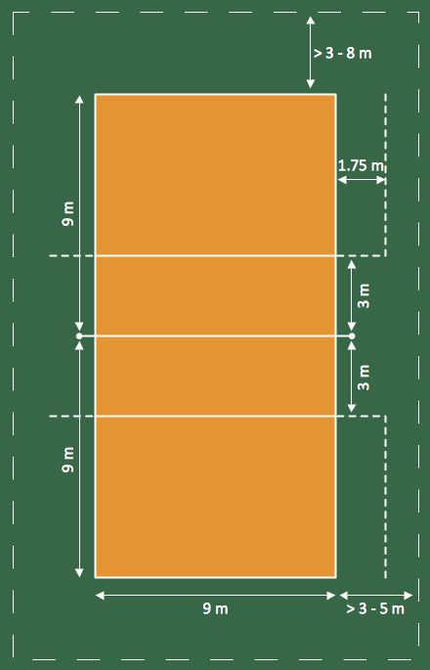

Slide 8
🏃 3. Kho-Kho Ground
: Layout, Rules and Regulations
Layout of Kho-Kho Ground
Shape: Rectangular
Length: 29 m
Width: 16 m
Important Parts:
Central Lane
Cross Lanes (8)
Posts (2 poles at both ends)
Free Zone

Slide 9
Rules and Regulations
Each team has 12 players (9 play at a time).
One team is chasing, the other is running.
Match consists of 2 innings.
Each inning is of 9 minutes.
Chaser gives “Kho” by touching the back.
Runner is out if touched by chaser.
Crossing central lane wrongly is a foul.
Runner cannot go outside the boundary.

Slide 10
